Slide 1
Alarm clock GUI Using python
By:
Taufeeq Hussain (1604-20-737-116 ) [IT-B]
Mohammed Faizuddin(1604-20-737-115) [IT-B]
Mohammed Aasim Hussain(1604-20-737-112) [IT-B]
Amaan Ahmed(1604-20-736-312) [MECH-B]

Slide 2


Python
Python is an interpreted high-level general-purpose programming language. Its design philosophy emphasizes code readability with its use of significant indentation. Its language constructs as well as its object-oriented approach aim to help programmers write clear, logical code for small and large-scale projects.
Python is dynamically-typed and garbage-collected. It supports multiple programming paradigms, including structured (particularly, procedural), object-oriented and functional programming. It is often described as a "batteries included" language due to its comprehensive standard library.rite

Slide 3
GRAPHICAL USER INTERFACE
Python offers multiple options for developing GUI (Graphical User Interface). Out of all the GUI methods, tkinter is the most commonly used method. It is a standard Python interface to the Tk GUI toolkit shipped with Python. Python with tkinter is the fastest and easiest way to create the GUI applications. Creating a GUI using tkinter is an easy task.
Import tkinter m = tkinter.Tk() ‘’’ widgets are added here ‘’’ m.mainloop()

Slide 4
Some functions which are used for gui :
Pack() method:It organizes the widgets in blocks before placing in the parent widget. Grid() method: It organizes the widgets in grid (table-like structure) before placing in the parent widget.
Bg: to set he normal background color. Font: to set the font Image: to set the image Width: to set the width Height: to set the height
Border: to set border
Entry: It is used to input the single line text entry from the user.
Title: To set the title of the widget.
CheckButton : To select any number of options by displaying a number of options to a user as toggle buttons.

Slide 5
Objective:
The objective of our project is to implement an alarm clock using Python. Python consists of some very innovative libraries such as time and tkinter which help us to build the project using the current time as well as to provide a user interface to set the alarm according to the requirement in 24-hour format.

Slide 6
Let’s check the steps to build an Alarm Clock program in Python:
Importing all the libraries and modules required
01
Putting forward a while loop which takes the argument of the time, the user wants to set the alarm on and automatically breaks when the time is up, with sound
02
Create a display window for user input.
03

Slide 7
Steps involved:
Define a function named as alarm() which takes the argument of (alarmtime).It contains a while loop with a Boolean function True which makes the program automatic to work.
time.sleep(1) halts the execution of the further commands given until we get the time value from the user later in the code and returns the background thread of the clock time going on at a regular interval.
Get the current time using currenttime which takes the argument of time.strftime()
the time is used to print the current time by string conversion using strftime().
If loop suggests that if the user input time alarmtime matches with the while loop ongoing time now, the message is printed as” Time to Wake up”.

Slide 8
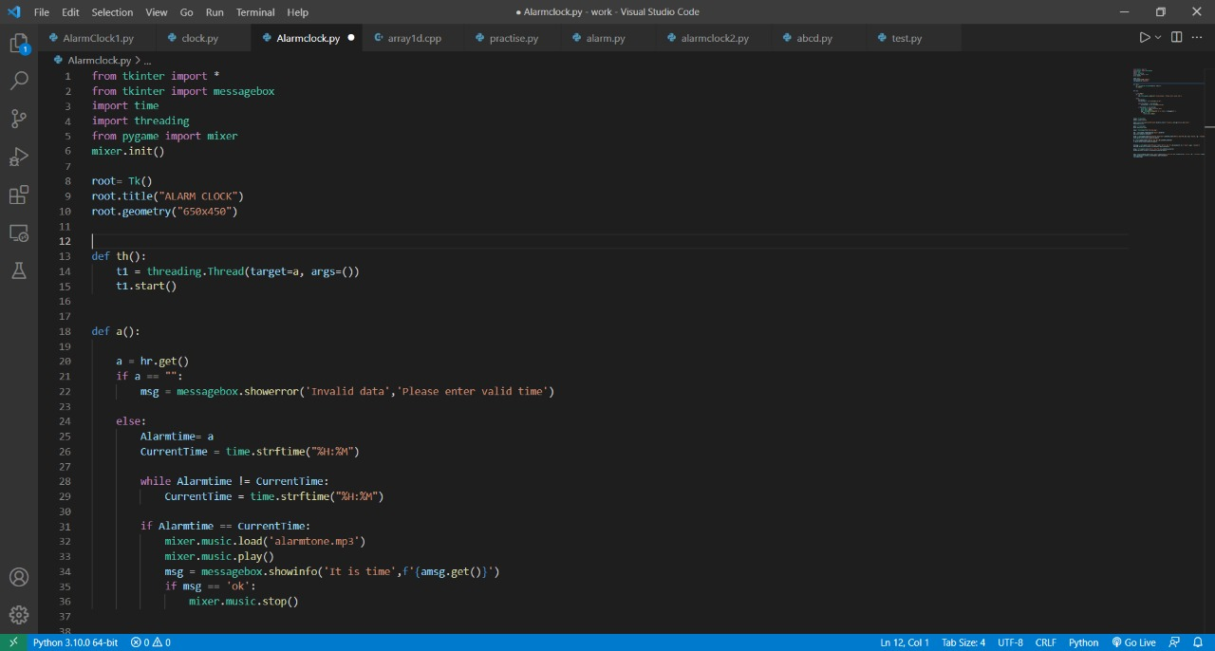

Slide 9
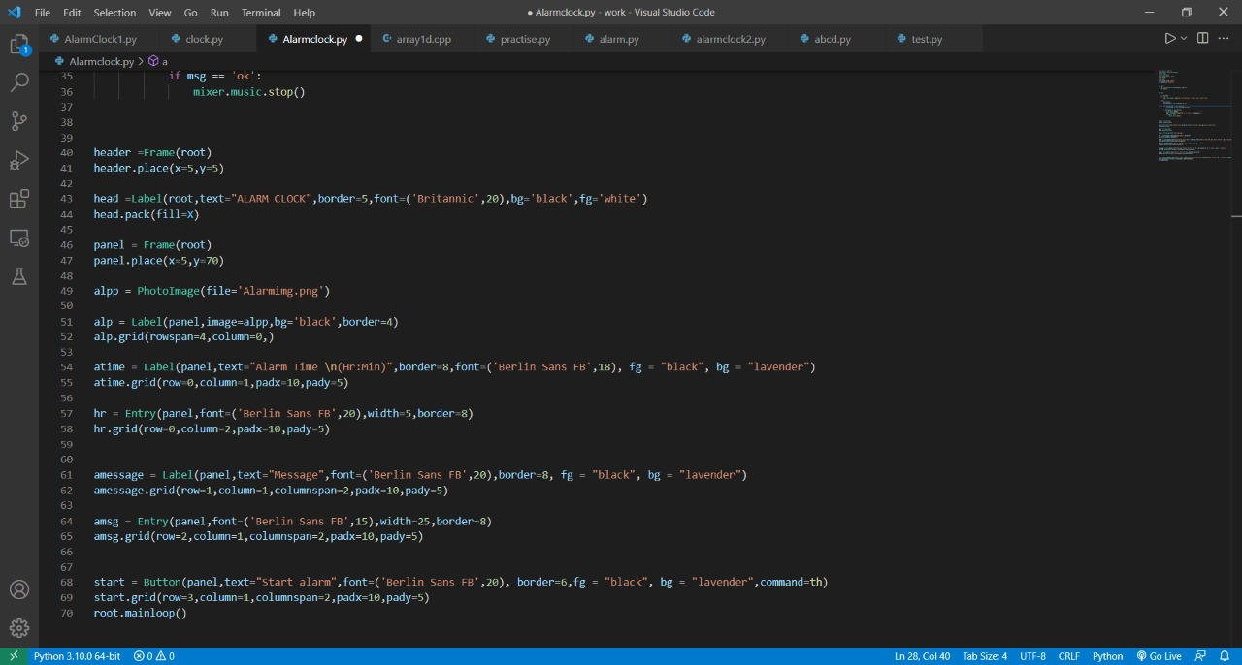

Slide 10
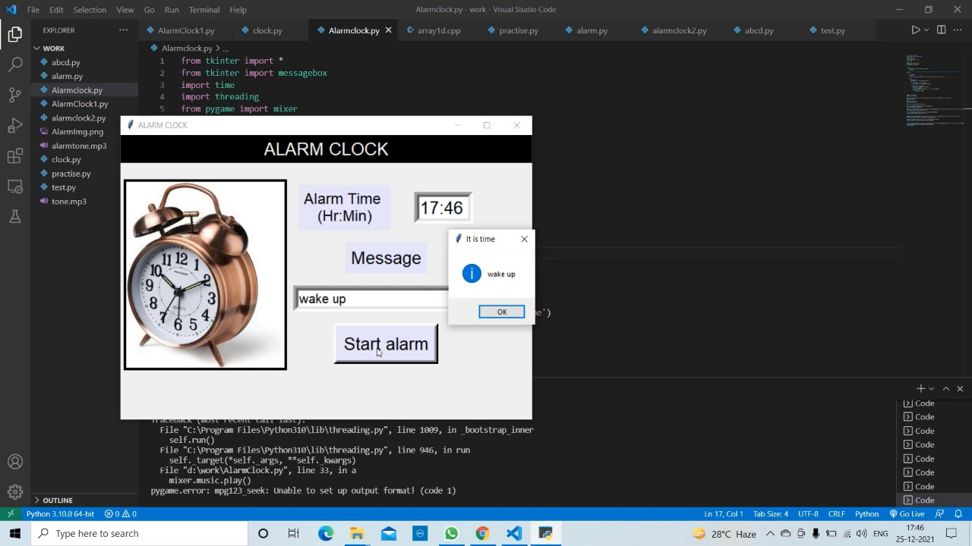

Slide 11
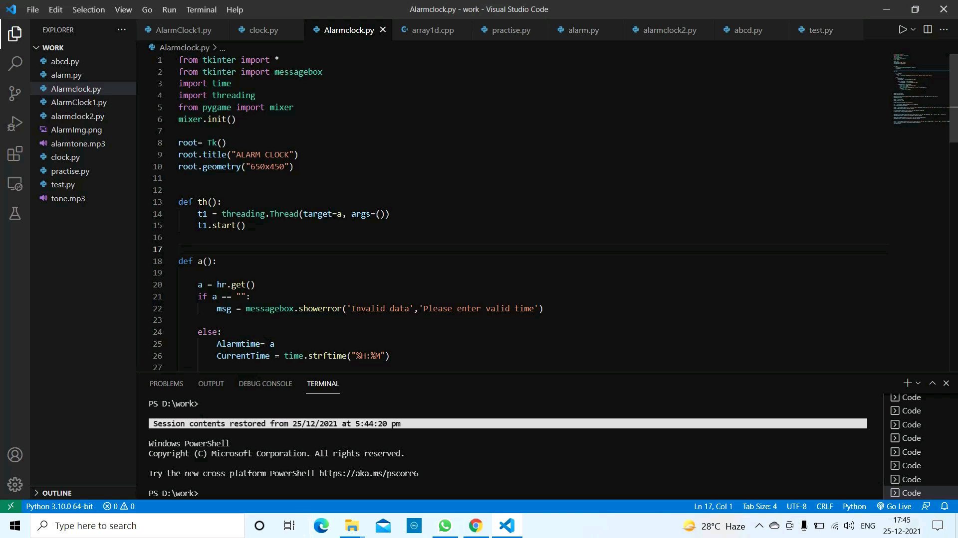

Slide 12
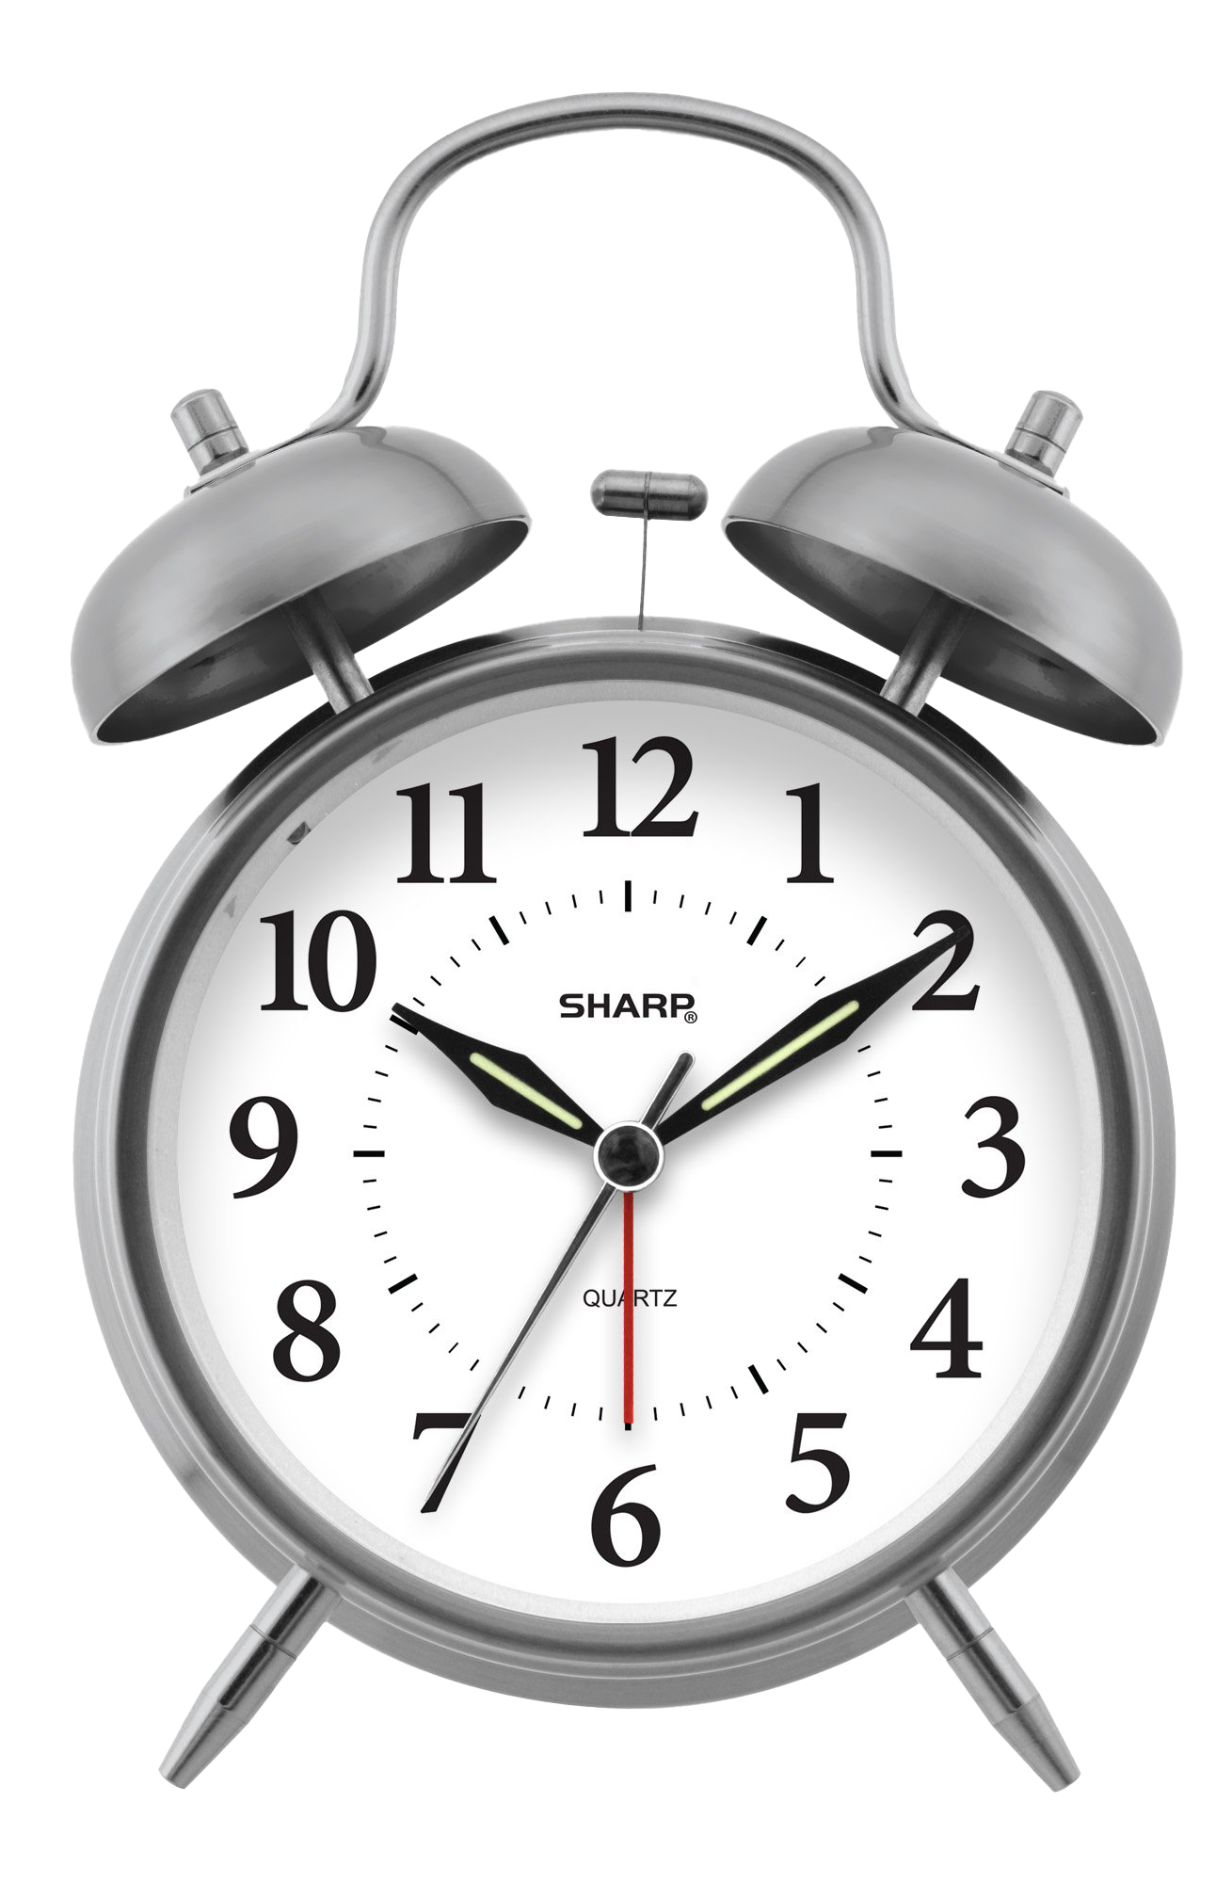
conclusion
With this project in Python, we have successfully made the Alarm Clock. We used the popular GUI library for rendering graphics on a display window. We learned how to extract the current time from the computer and to use it for manipulation using the Time library. This way we can set an alarm in the computer interface using python programming which rings with the default machine sound for Windows.

